Slide 1

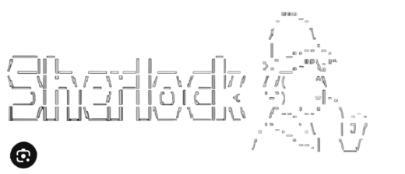


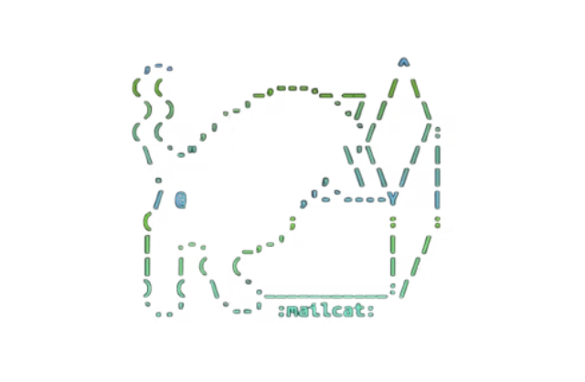

OSINT MACHINE
VIRTUAL MACHINE

Slide 2

Introduction
This presentation details the process of investigating a suspicious digital identity using an isolated Ubuntu-based OSINT virtual machine. We will explore how specialized tools within the VM help determine if an identity is malicious, part of a scam, or an impersonation attempt.

Slide 3

Use Case: Investigating a Suspicious Digital Identity
Investigative Objectives
Verify email authenticity (real, leaked, disposable, fake).
Check username footprint across online platforms.
Analyze URL for phishing indicators and malicious scripts.
Inspect domain/IP for risky hosting or newly registered infrastructure.
Identify scam patterns tied to the identity.

Slide 4






Tools Used in the Use Case
Our custom Ubuntu VM is equipped with a suite of specialized OSINT tools, each designed to investigate a specific layer of a digital identity.
Mailcat
BlackBird
GhostTrack
Email leak check, reputation score, risk rating.
Username investigation on social platforms and forums.
Activity monitoring, behavioral mapping.
Carbon14
WebOSINT
URL metadata, redirects, phishing indicators.
Domain/IP/hosting investigation, WHOIS, SSL, DNS.

Slide 5
Live Demonstration
Our live demonstration showcases the systematic approach to investigating the suspicious digital identity within the secure, isolated VM environment.

Slide 6

CONCLUSION
All identity components—email, username, URL, and domain—were thoroughly analyzed using five specialized tools within the VM, ensuring a comprehensive assessment. This VM can be efficiently reused for any future digital identity investigations.

Slide 7
THANK YOU !
GROUP MEMBERS
Fabiha Faheem CR-23002
Yumna Afaq Khan CR-23007
Emaan Rashid CR-23029
Mahrukh Arif CR-23302
Mayra Ahmer CR-23303
Fatima Asif CR-23304

